Slide 1
Trees, Air Quality, and Wealth Distribution in New York City
Annie Bishai | April 18, 2022

Slide 2
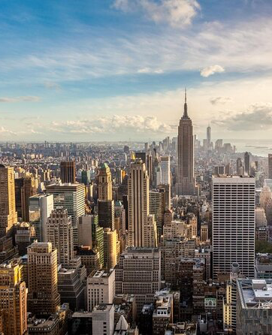
The Question
Can metrics of air quality and trees (health, density) be used to accurately predict household income in census tracts of NYC?

Slide 3
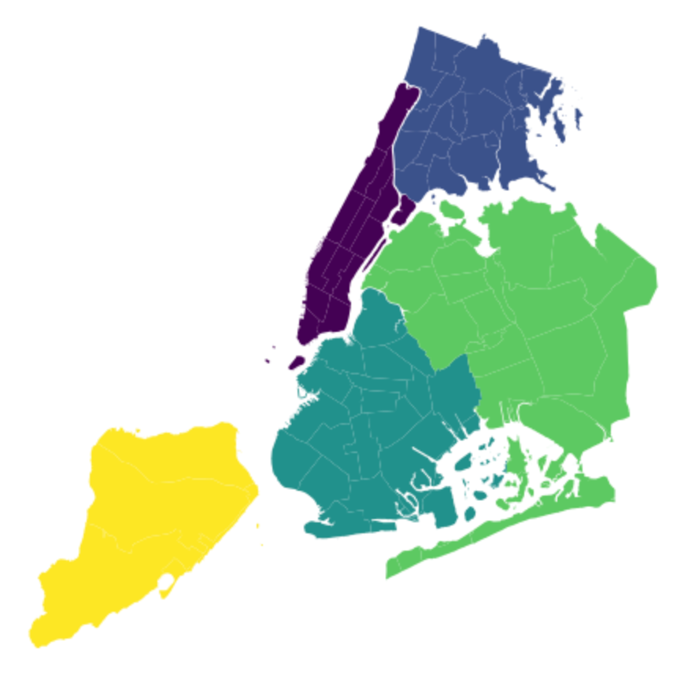
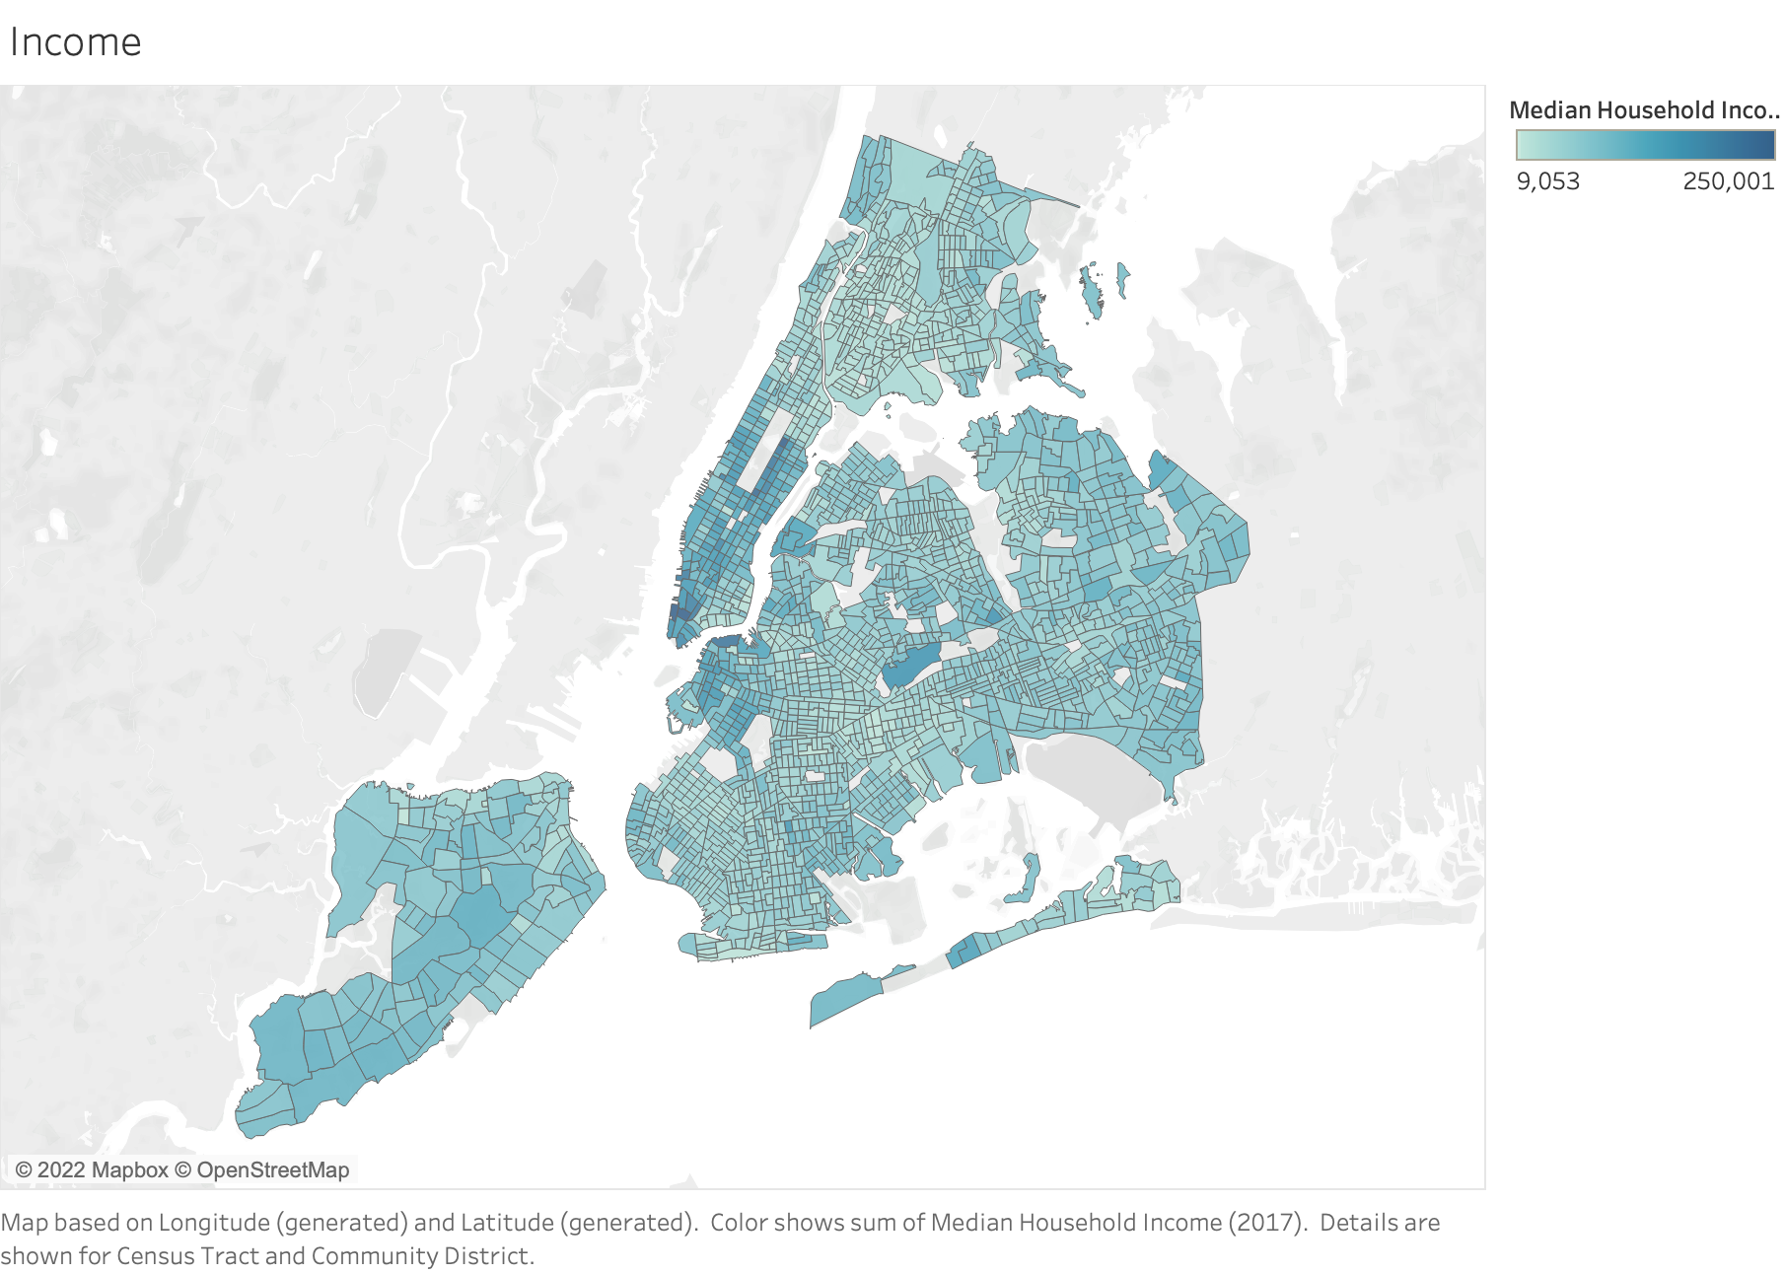
Income
Manhattan
Bronx
Brooklyn
Queens
Staten Island
(2017)

Slide 4

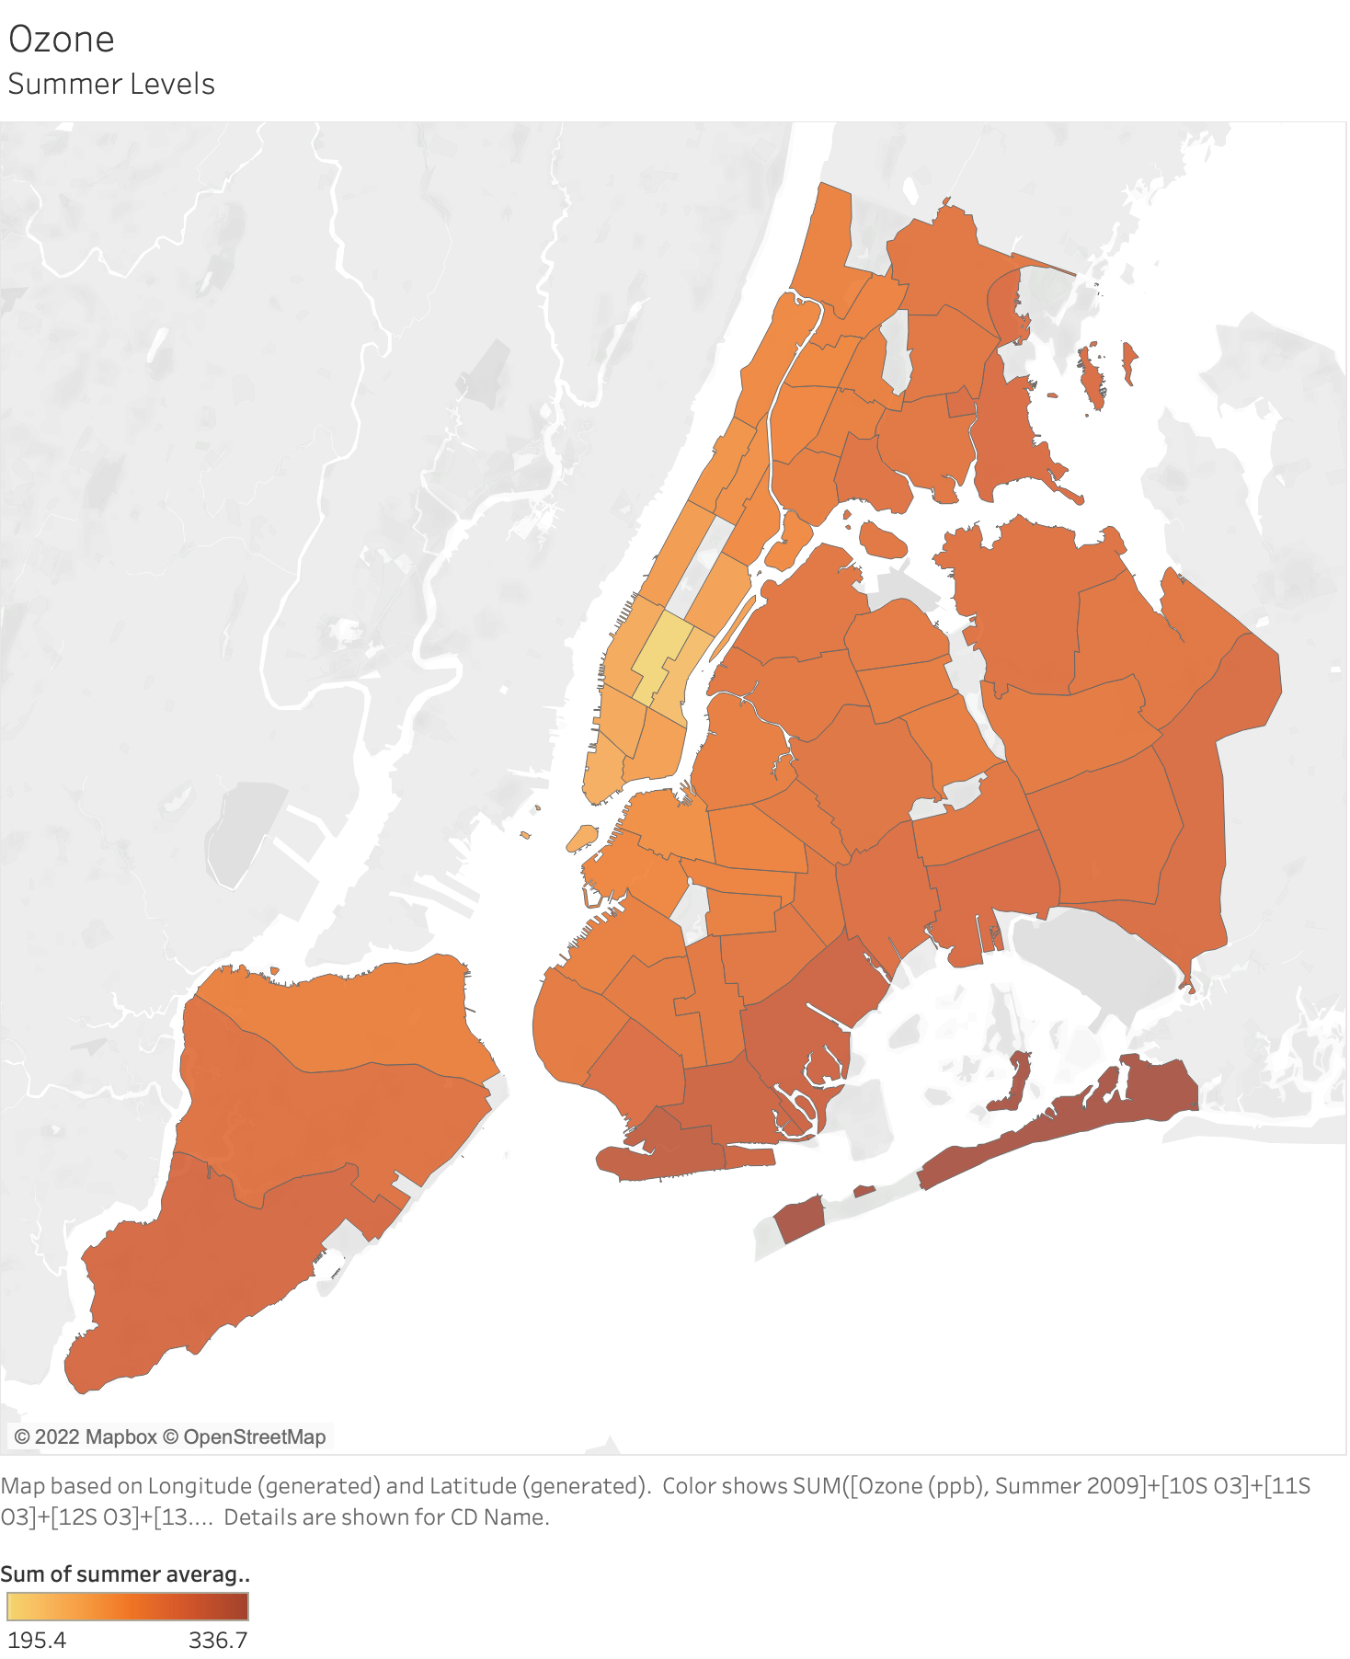
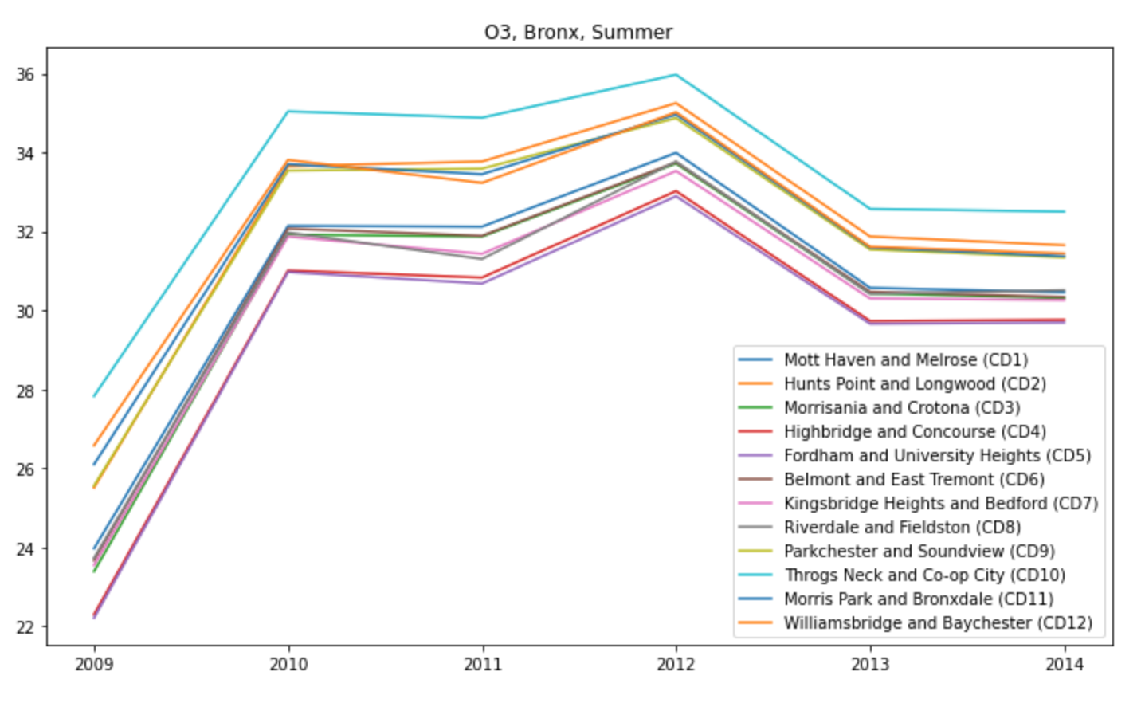
Air Quality: Ozone
Notes:
NYC Open Data
Ozone is a common air pollutant that can harm breathing and worsen asthma and other respiratory conditions.

Slide 5
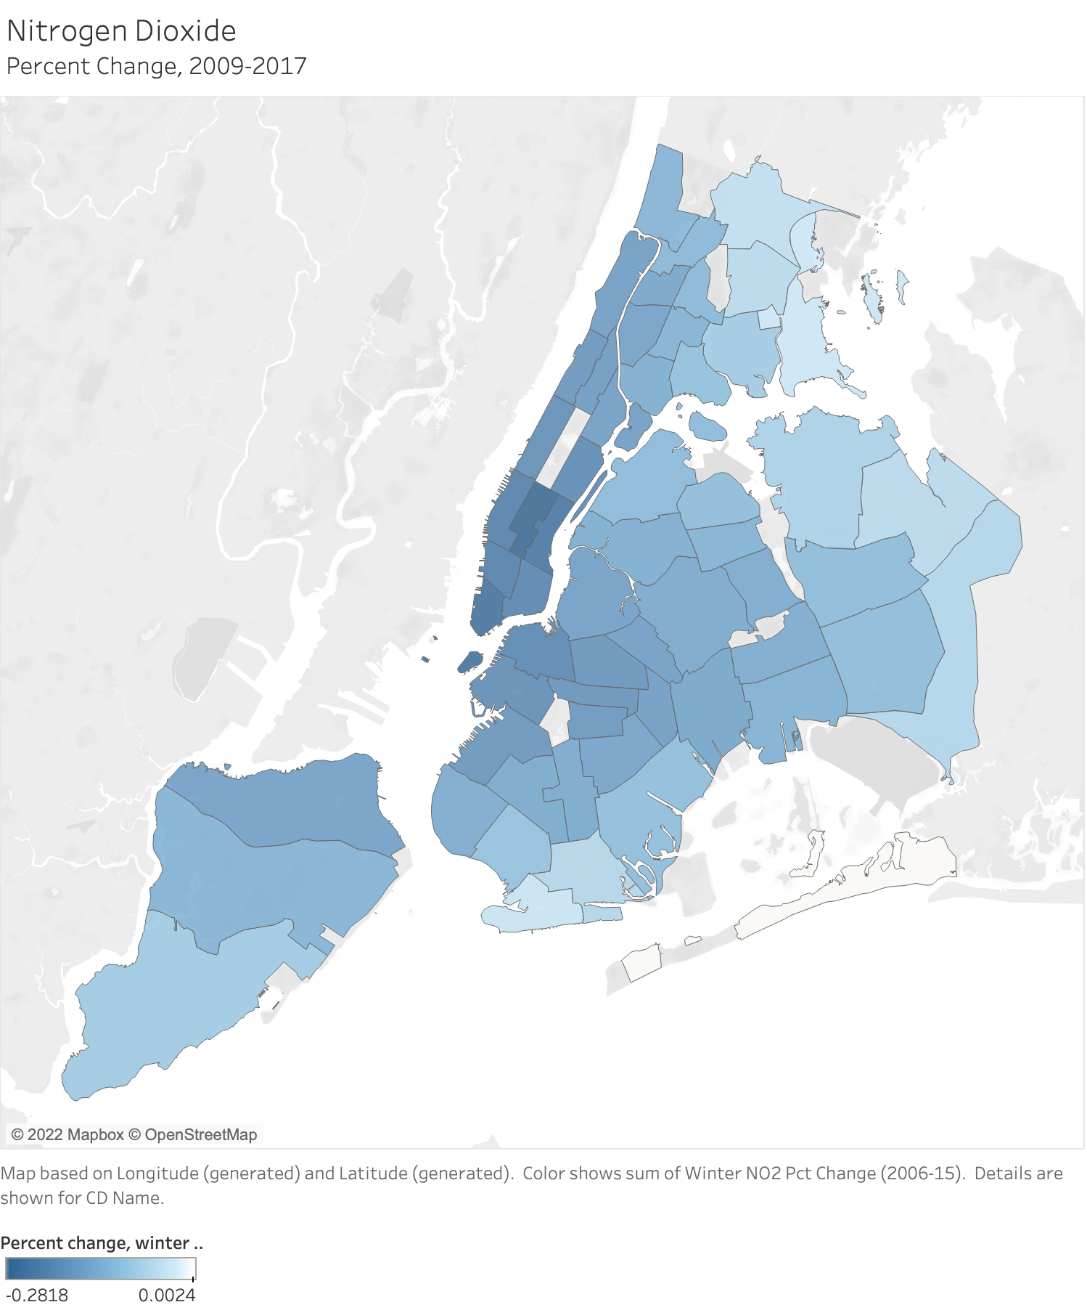
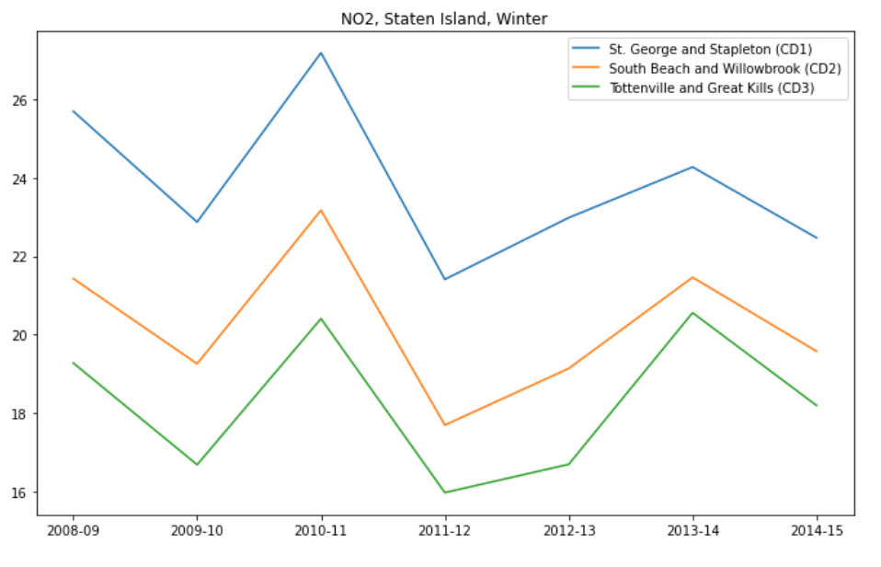
Air Quality Trends: NO2 2006-15
Notes:
Nitrogen oxides (NOx), which include nitric oxide (NO) and nitrogen dioxide (NO2), are a group of pollutants formed by combusion that can cause damage to lung tissue, breathing and respiratory problems, as well as contribute to smog and acid rain.

Slide 6
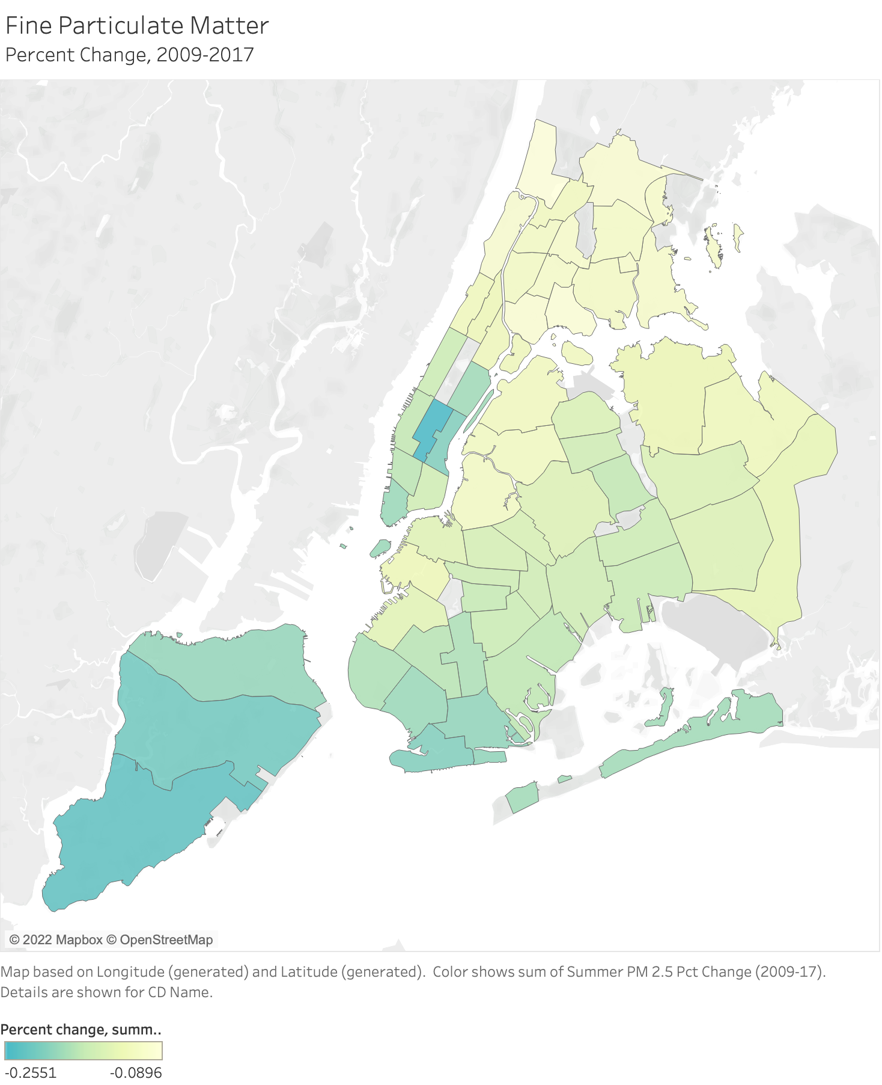
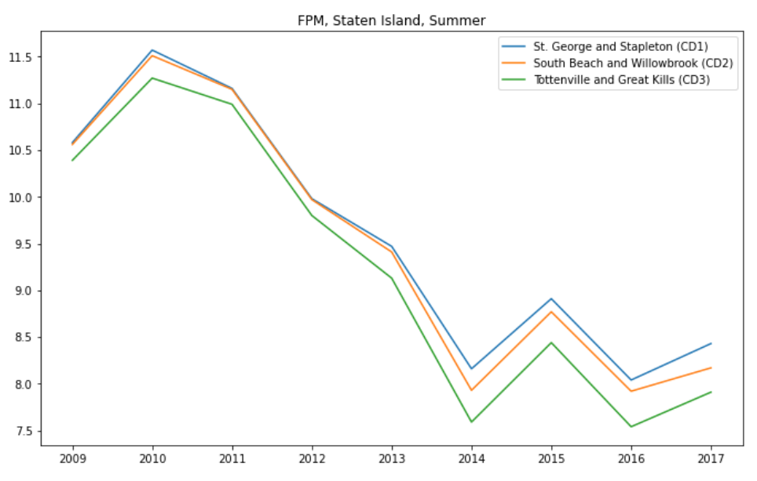
Air Quality Trends: PM 2.5 2009-17
Notes:
Fine particles are emitted by vehicles, building boilers, and other combustion

Slide 7
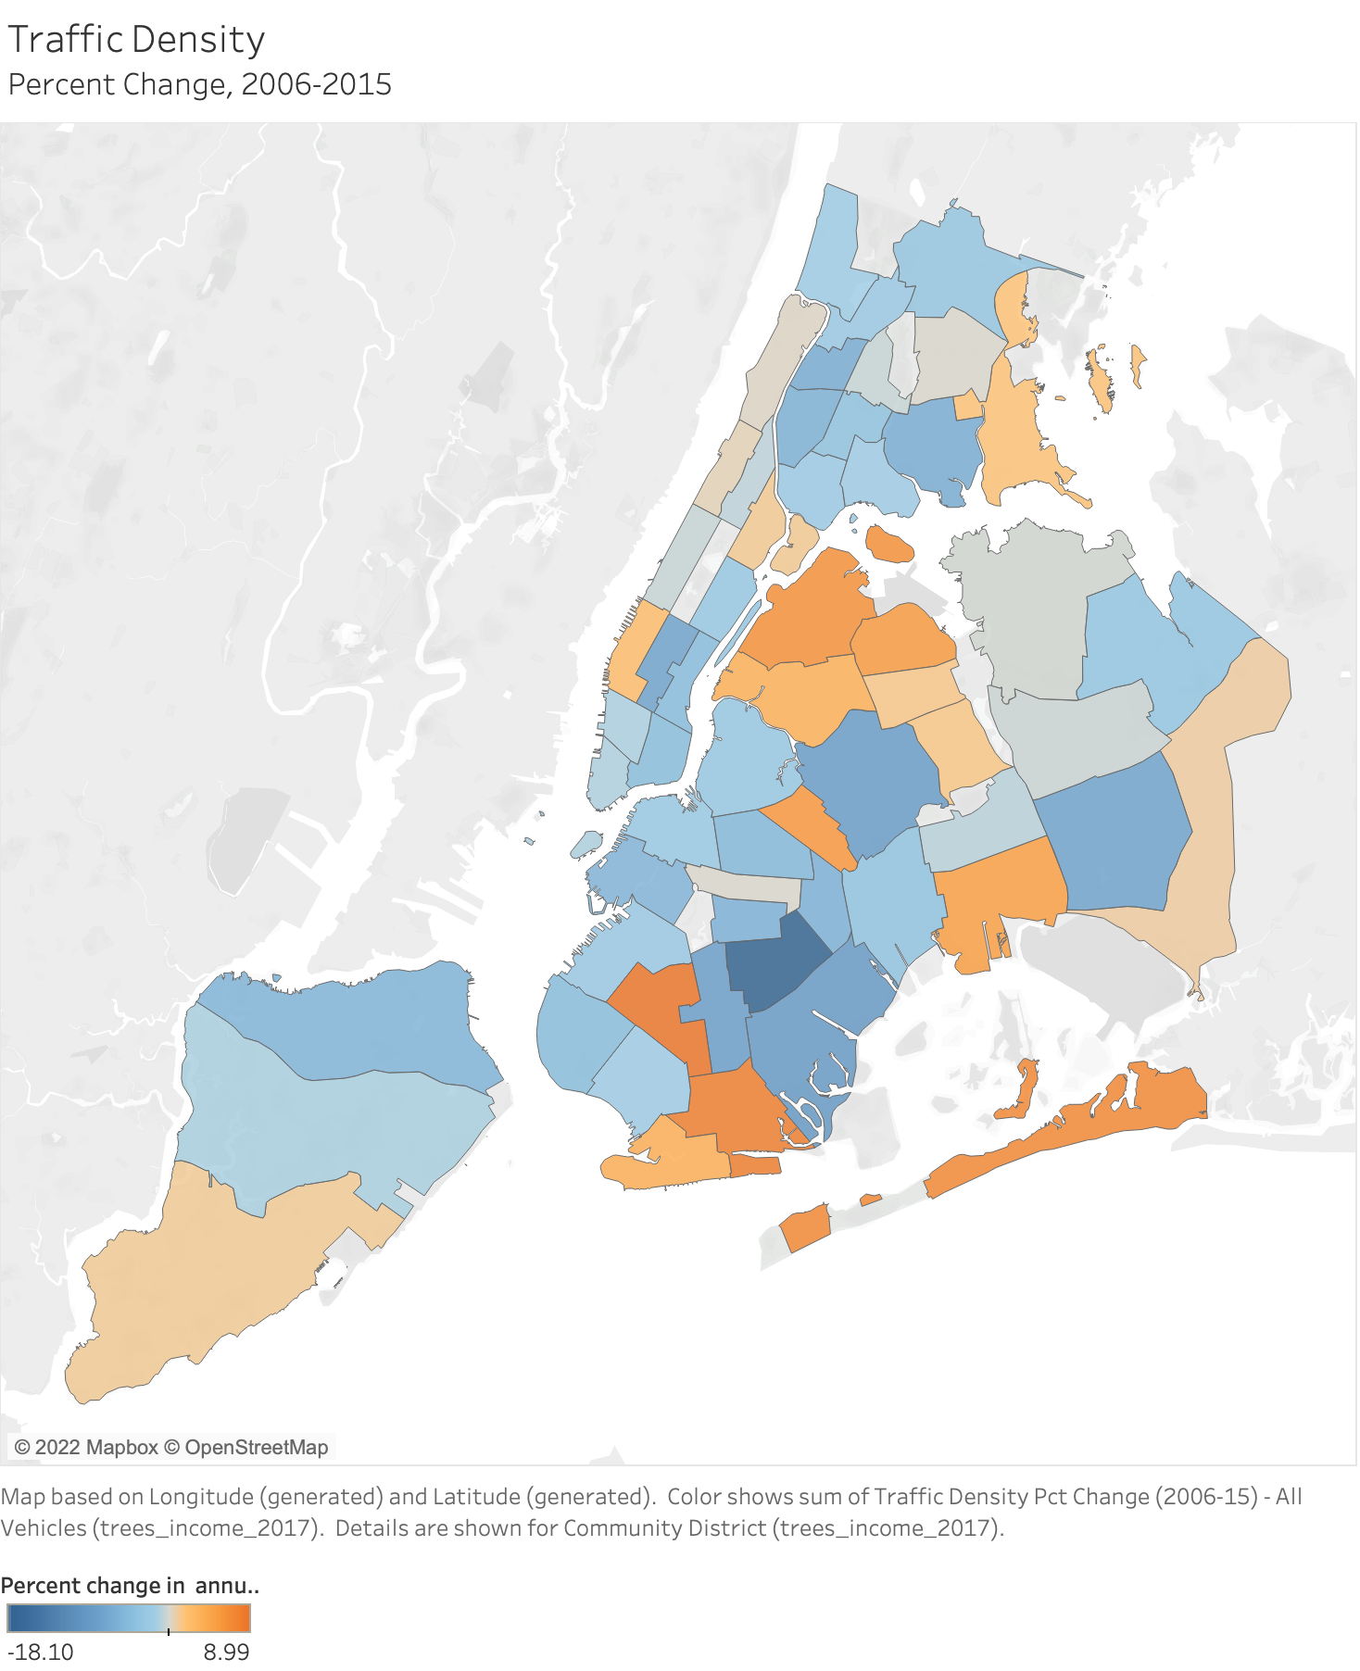
Air Quality Trends: Traffic 2006-15

Slide 8
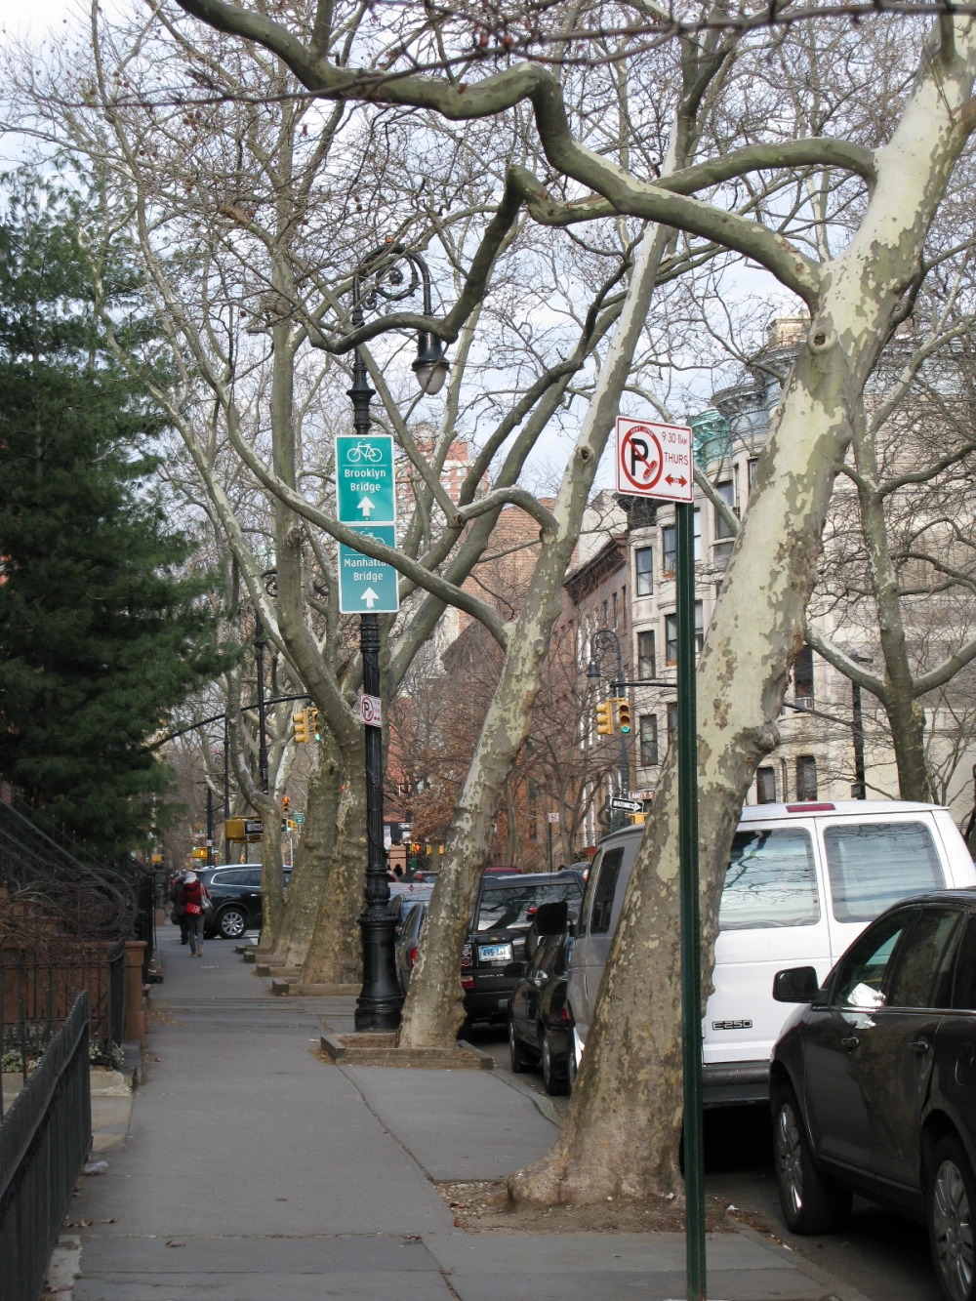
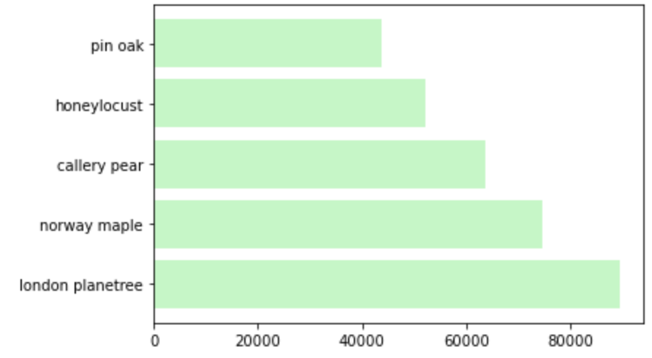
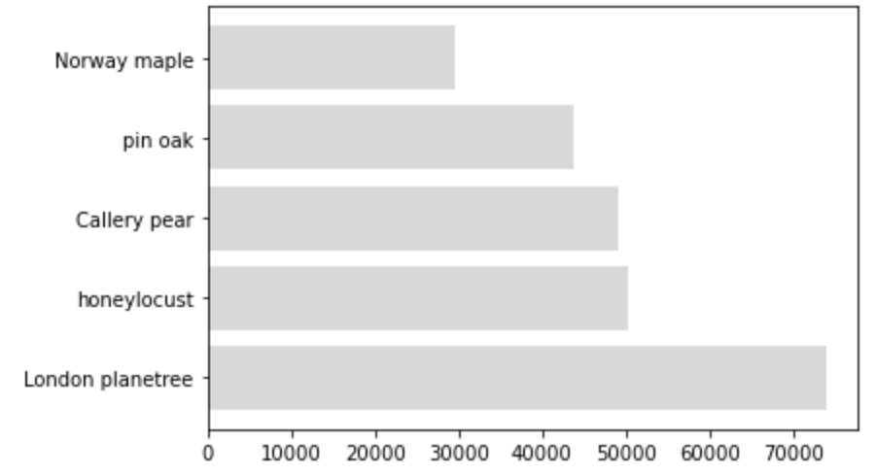
Tree Census
Alive?
Subjective health
Species
Diameter
Sidewalk damage
Location
2005
2015
Notes:
-explain structure and methodology of tree census
Large healthy trees greater than 77 cm (30 in) in diameter remove approximately 70 times more air pollution annually (1.4 kg/yr) than small healthy trees less than 8 cm (3 in) in diameter (0.02 kg/yr)k. Air quality improvement in New York City due to pollution removal by trees during daytime of the in-leaf season averaged 0.47% for particulate matter, 0.45% for ozone, 0.43% for sulfur dioxide,
- London Planetree has largest mean diameter (potential inaccuracy)

Slide 9
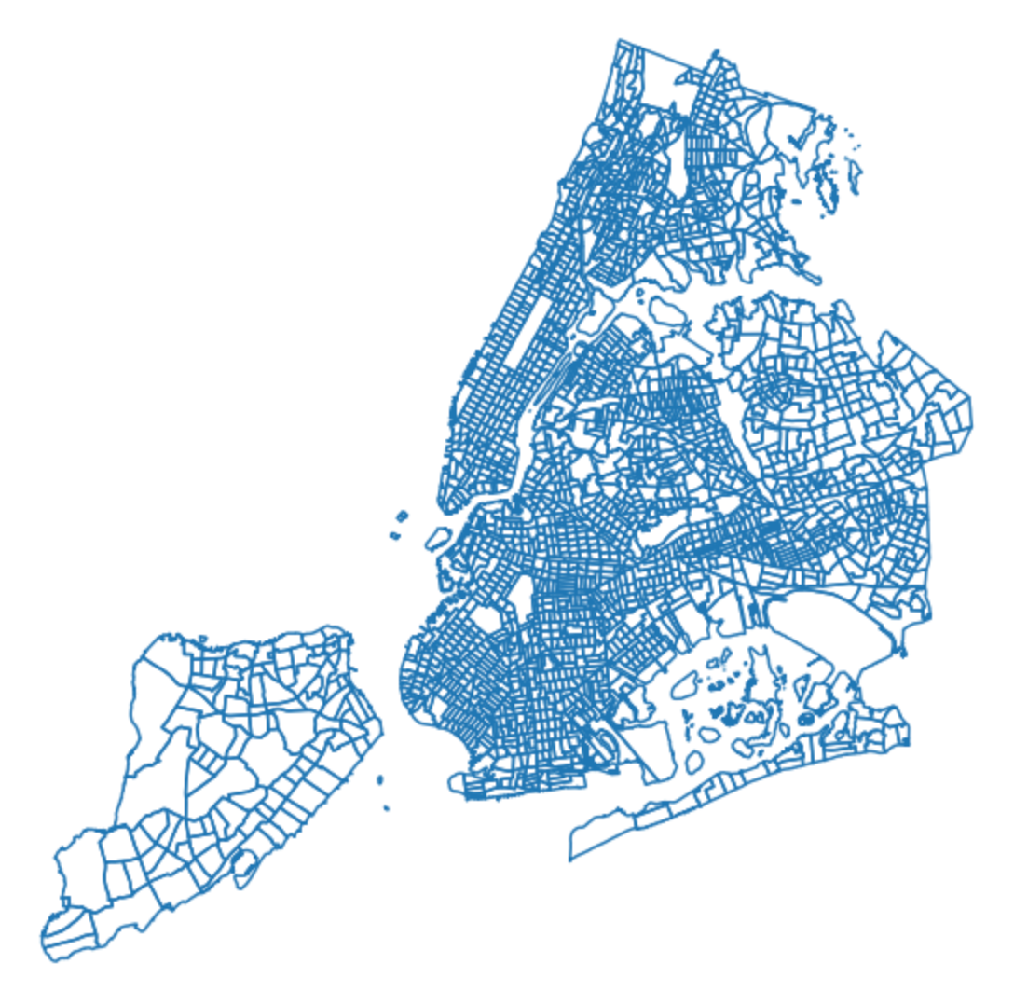
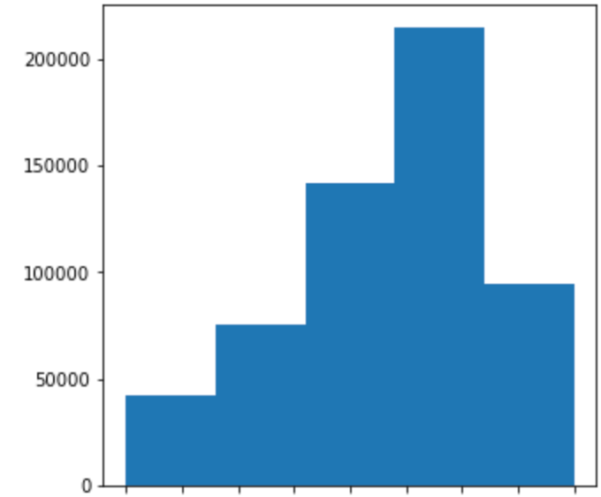
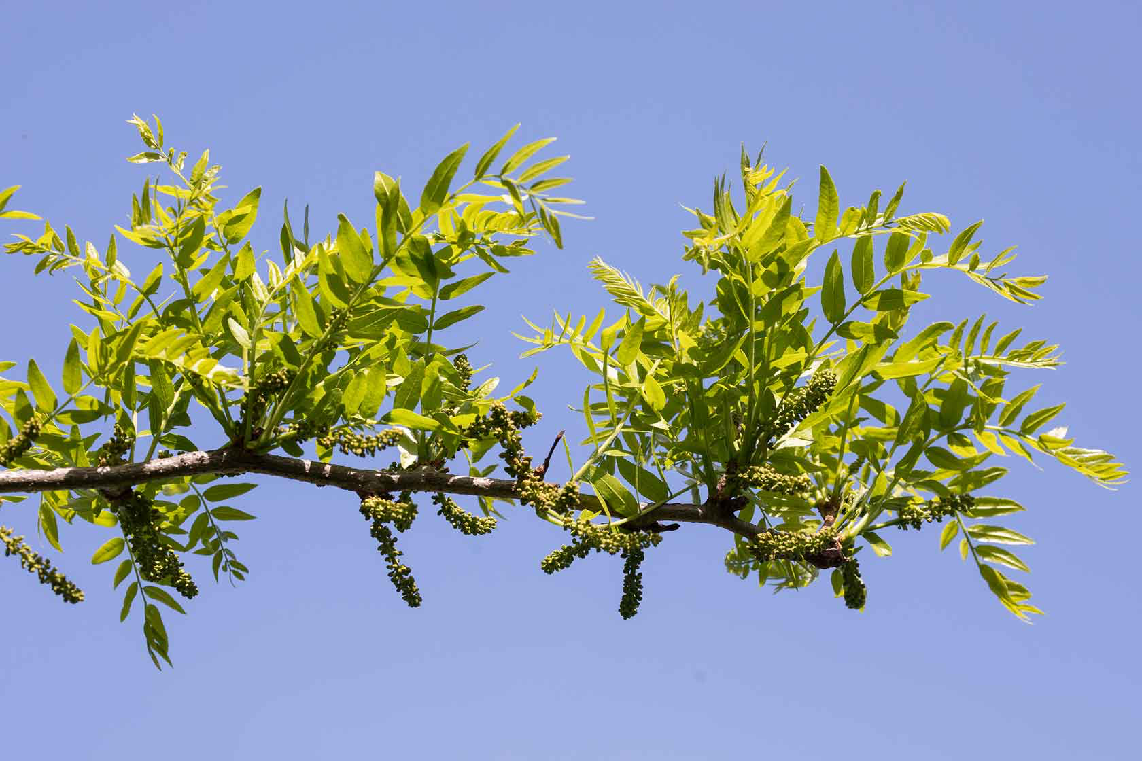
Tree Census cont’d
Queens
Brooklyn
Bronx
Staten Island
Notes:
Switch quickly to explain overlay

Slide 10
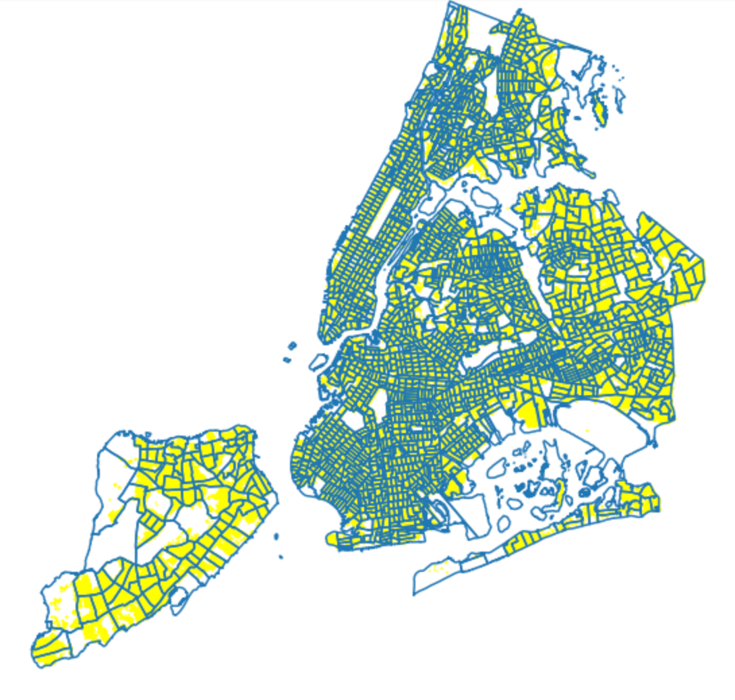
Tree Census cont’d
Queens
Brooklyn
Bronx
Staten Island

Slide 11
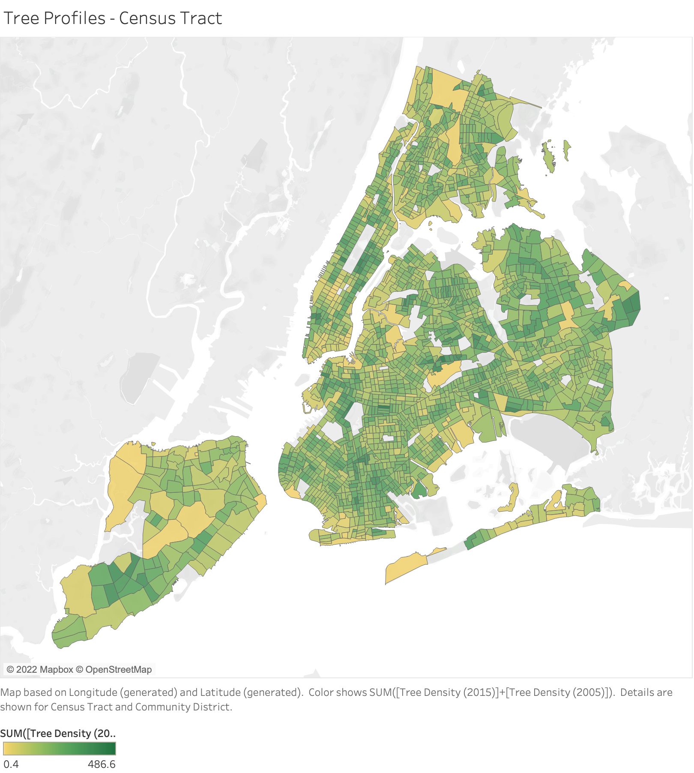
Tree Density, 2015

Slide 12

Modeling
Bagging
Random Forest
ExtraTrees
Gradient Boosting
Adaboost
Baseline
RMSE: $31,613.13
Random Forest Model:
RMSE: $18,661.84
R2 score: 0.651
Based on MSE, model is a 65.15% improvement from null
Based on RMSE, model is a 40.97% improvement from null

Slide 13
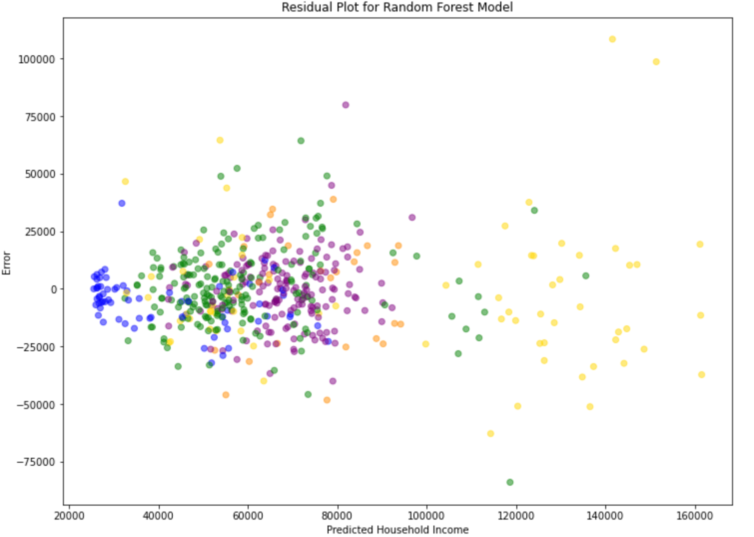
Model Evaluation
Manhattan
Bronx Brooklyn
Queens
Staten Island

Slide 14
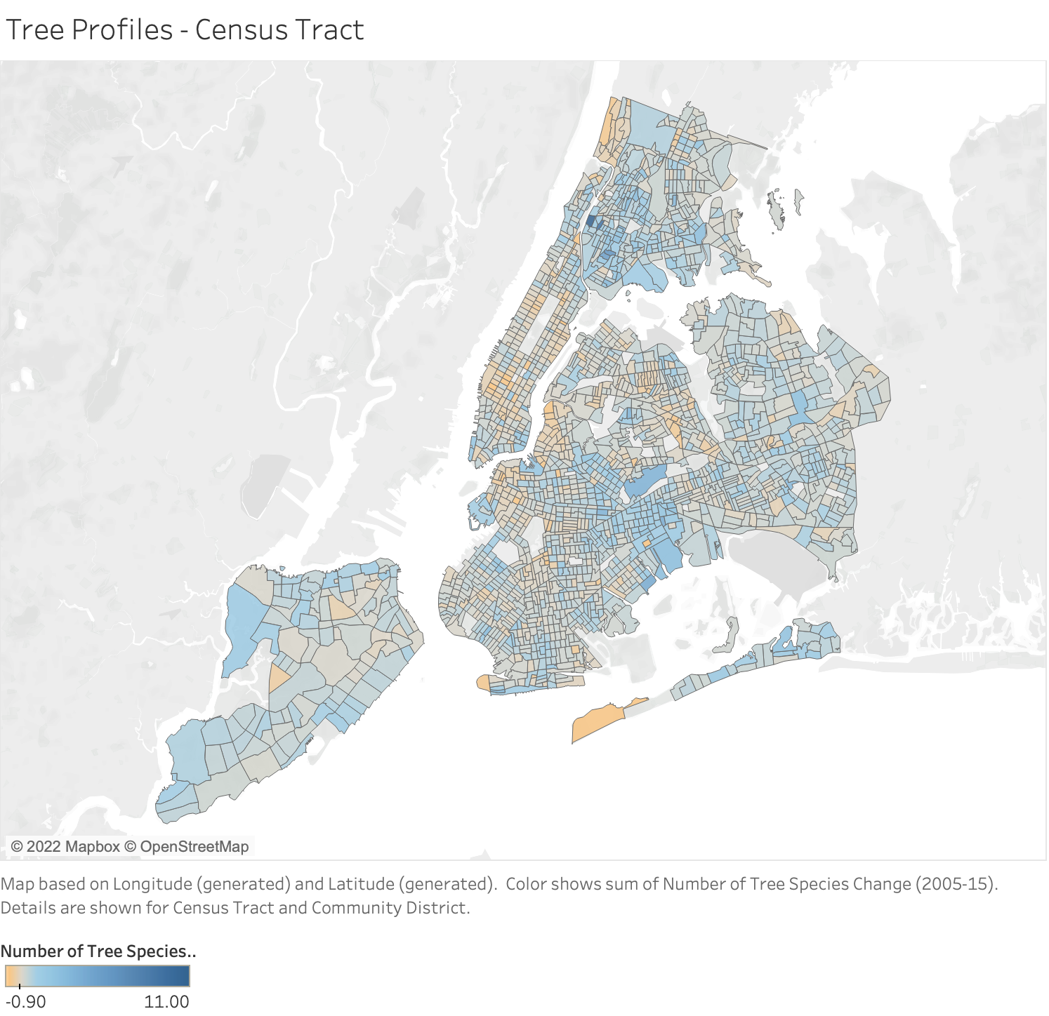
Feature Importance
Change in number of trees (‘05-’15)
Winter NO2 2012-13
Winter NO2 change
Summer NO2 2017
Tree count 2005
Number of species 2005
Summer ozone 2010
Summer ozone 2013
Tree density change
Tree count change
SO2 change
Tract area
Near park %
Mean Tree Diameter
Number of species 2015
Summer 2017 PM 2.5
Notes:
Traffic not up there
PM 2.5 not till 15th

Slide 15
So what?
Predicting potential impact of tree-planting, pollution-reduction efforts on geographic income stratification
Identifying areas of high risk for adverse health effects of climate change/pollution

Slide 16
What next?
Make this model better: more feature engineering
Bring in more info on relevant policy/budget changes
Fit to specific geographies (boroughs)
Different y-variable?
Read the lit!

Slide 17
Thank you!
This presentation has been designed using resources from PoweredTemplate.com
London Planetree image: https://matthewwills.com/2012/01/14/not-as-plain-as-all-that/

